Slide 1
Level 1 Task 3
Raviraj mane

Slide 2
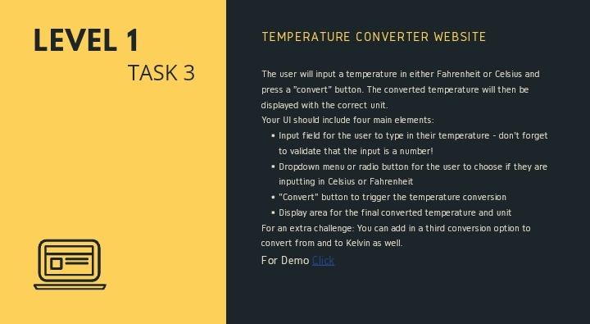

Slide 3
